Slide 1
Java Programming
152-130 Module 3

Slide 2
The ArrayList Class
Section 1

Slide 3
The ArrayList Class
Resizable array
Implements the List interface
Imported from the java.util package
Stores multiple objects with one variable
Expands and shrinks in size automatically when necessary
Can remove elements

Slide 4
The ArrayList Class
You can store any object type in an ArrayList
List list = new ArrayList();
list.add("Java is fun");
list.add(new Integer(5));
list.add(new Date());
Integer i = (Integer)list.get(0); // Error!!
Date d = (Date)list.get(2);

Slide 5
Type Safety
How do we ensure that the operations done with the objects in the list are only those that are valid for the object type?
Type safety is the restriction of code so that only legal operations are performed on objects
With a generic type

Slide 6
Generics
With generics, we can provide type safety at compile time
Syntax: List<E> test = new ArrayList<>();
The E (sometimes T) stands for the element/type of objects stored
Must be a class type or a wrapper class (no primitive types)
List<String> list = new ArrayList<>();
list.add("Java is fun");
list.add(new Integer(5)); // Error!!

Slide 7
The ArrayList Class Methods
.add(e) adds an element to the end of the list
.add(i, e) overloaded version to insert an element at a given index
.set(i, e) replaces an element at a given index
.get(i) retrieves an element at a given index (element remains in the list)
.remove(i) retrieves an element at a given index (element removed from the list)
.clear() removes all elements from the list
.size() returns the count of elements in the list
.indexOf(e) returns the first index of a given element in the list, or -1
.contains(e) returns a boolean if the list contains the given object

Slide 8
ArrayList’s toString Method
Prints a representation of all items in the ArrayList
Is called automatically when concatenated or printed
System.out.println(nameList.toString());
>> [Mario, Gerald, Maya]
System.out.println(nameList);
>> [Mario, Gerald, Maya]
System.out.println("Names " + nameList);
>> Names [Mario, Gerald, Maya]

Slide 9
Capacity
The ArrayList class actually contains an array that does the storage
ArrayList provides a convenient facade with lots of functionality
An ArrayList's capacity is how many items that internal array can hold
By default, initial capacity is 10
When the 11th item is added, capacity is doubled

Slide 10
Capacity
Whenever an ArrayList needs to grow, it doubles the length of its internal array
10 → 20 → 40 → 80 → 160 → 320 → 640 → 1280 → 2560
Makes a new array, copies the old contents into it
If you know you need lots of storage, specify the initial capacity in the constructor
List<String> list = new ArrayList<>(1000);

Slide 11
Storing Your Own Objects
Change the generic type
List<Student> students = new ArrayList<>();
students.add(new Student("Drako", "Malfoy"));
List<Candle> candles = new ArrayList<>();
candles.add(new Candle());

Slide 12
Design Best Practices
Using polymorphism, we can declare an ArrayList as its interface List
List<String> list = new ArrayList<>();
Allows list to be any class type that implements the List interface (such as Vector or LinkedList)
More flexibility if we change the list type

Slide 13
Collections
Section 2

Slide 14
What is a Collection?
A group of objects stored as a single unit
We’ve just looked at ArrayList, which is a type of List
Other general types:
Set
Queue
Deque ("deck")
All of the above implement the Collection interface

Slide 15
Questions to Keep in Mind
Does it allow null items?
Does it allow duplicate items?
Does it store items in order?
How efficiently can you find an item?
How efficiently can you insert/delete an item?

Slide 16
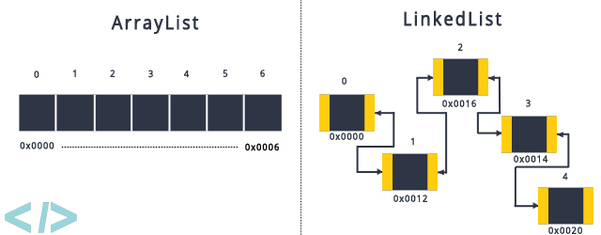
ArrayList
ArrayList uses contiguous memory allocation
Elements occupy successive memory locations

Slide 17
LinkedList
LinkedList uses linked allocation
Each element contains a reference to its successor (a link)

Slide 18
List Efficiency
LinkedList is fast to add/remove elements in the middle
You don’t have to shift the rest

Slide 19
Iterators
Cycles through the elements of a list in index order
hasNext() checks if more elements
next() retrieves the next element
Iterator will have generic type to match the List
Iterator<String> itr;

Slide 20
Iterators
List<String> stuff = new ArrayList<>();
stuff.add("First");
stuff.add("Second");
stuff.add("Third");
Iterator<String> itr = stuff.iterator();
while (itr.hasNext()) {
String item = itr.next();
System.out.println(item);
}
We don't have to cast
the result of itr.next()

Slide 21
Why?
If you want to modify the list while looping through it
If another part of your program needs to loop over list elements, but you don't trust it with the actual list
Hides the actual type of collection
https://www.quora.com/Why-should-I-use-an-Iterator-in-Java-in-the-first-place

Slide 22
ListIterator
Can move backwards ( previous()) as well as forwards
Also a hasPrevious() method
Tracks position using a cursor
ListIterator<String> it = stuff.listIterator();

Slide 23
Review: Lists
Allow any number of nulls
Allow any number of duplicates
Maintain insertion order

Slide 24
Maps
Contains pairs of elements: a key and a value
To retrieve a value, supply the key
Fast retrieval
Does not implement java.util.Collection

Slide 25
HashMap
HashMap uses an algorithm to calculate a hash code for an element
Equivalent elements should generate equal hashes
Every object inherits a hashCode() method from the Object class, but it's not very robust
Overriding equals and hashcode

Slide 26
HashMap Generics
The hash code becomes a unique key
Data type of key and value can be specified with generics
The key is a String, the value is an Integer
(Like ArrayList, we declare the variable as the supertype Map)
Map <String, Integer> map;

Slide 27
put() and get()
Map <String, String> capitals = new HashMap <>();
capitals.put("USA", "Washington, D.C.");
capitals.put("Canada", "Ottawa");
capitals.put("Mexico", "Mexico City");
String key = "Canada";
String msg = "The capital of " + key;
msg += " is ";
msg += capitals.get(key); // get value

Slide 28
HashMap of Lists
If you ask a user to enter X number of meal types, and you want to find the average calories for each meal type...?
How do you know how many lists to make?
List<Meal> breakfasts = new ArrayList<>();
List<Meal> lunches = new ArrayList<>();

Slide 29
Map of Lists of Meals
By using a List as the value, you can store multiple values for each key
Create a HashMap with
String keys
List<Meal> values
Map <String, List<Meal>> mealMap = new HashMap <>();

Slide 30
Do We Have a List for Meal Type X?
As you read meal types from the user, check if you have a list for the current meal type
If you don’t, create an empty list and put it in the map
String mealType = keyboard.nextLine();
if (!mealMap.containsKey(mealType))
mealMap.put(mealType, new ArrayList<Meal>());

Slide 31
Add Meal to Correct List
Use the meal type String to get the right list
Add the meal object to it
List<Meal> list = mealMap.get(mealType);
list.add(new Meal(...));

Slide 32
Why containsKey() ?
If you use get() to ask for a nonexistent key, you get a null
Test if key exists by using containsKey() first

Slide 33
Multiple Counters
Another common use for HashMap is running multiple counters at once
Map<String, Integer> counts = new HashMap<>();
if (!counts.containsKey("Lunch"))
counts.put("Lunch", 0);
counts.put("Lunch", counts.get("Lunch") + 1);

Slide 34
Iterating Over Maps
To view all the key/value pairs in a Map, you can loop over all of its entries
entrySet() method returns a Set of Map.Entry objects
Each entry contains a key and its associated value

Slide 35
entrySet()
Map <String, Double> myMap = new HashMap <>();
for (Map.Entry<String, Double> entry : myMap.entrySet()) {
String key = entry.getKey();
double value = entry.getValue();
System.out.println(key + "," + value);
}

Slide 36
Review: Maps
Stores key/value pairs
No duplicate keys, duplicate values okay
Allows a single null key, unlimited null values
Some Map implementations preserve order
TreeMap: ascending key order, can sort keys
LinkedHashMap: insertion order
Fast retrieval, insert, and delete

Slide 37
Sets
Like the "keys" part of a map
Elements are unordered
No duplicates
One null value
Good for fast retrieval when you must search for an element by value

Slide 38
HashSet
HashSet uses each element's hash code to eliminate duplicates
When you add an element to a HashSet, it checks to see if it already contains the element's hash code
Sometimes collisions occur, so the HashSet follows up with the equals method

Slide 39
What is a Hash Code?
An integer value that characterizes an object
HashSet uses an algorithm to create this hash code for each object in the set
This is done to make searching for objects faster

Slide 40
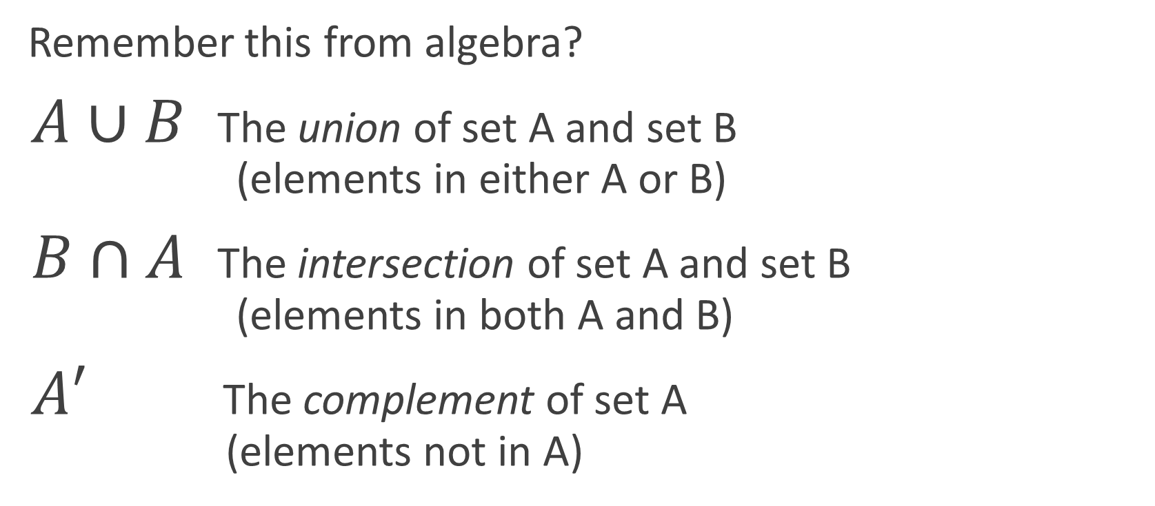
Set Operations
Remember this from algebra?
$A∪B$ The union of set A and set B (elements in either A or B)
$B∩A$ The intersection of set A and set B (elements in both A and B)
$A′$ The complement of set A (elements not in A)

Slide 41
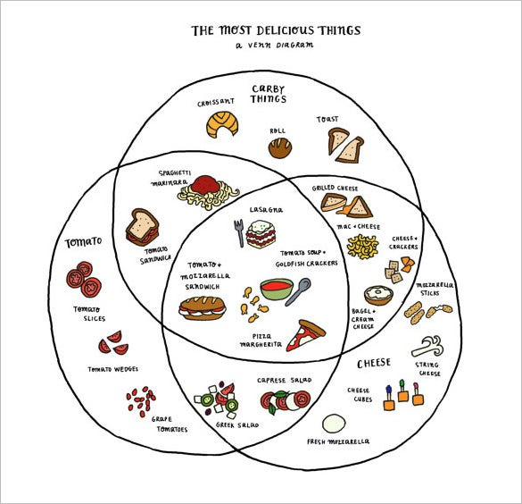
Venn Diagrams
Define three HashSets of Strings
Fill each set with the items in its circle
Use Java's set operations to find the union, intersection, and complement
https://www.template.net/design-templates/print/sample-funny-venn-diagram/

Slide 42
No Duplicates
Sets don't allow duplicate elements
If you combine all carby things with all cheesey things, you won't end up with two "Lasagna"s

Slide 43
Intersection of Cheesey and Tomatoey
Start with the cheesey set
Retain only tomatoey elements
Set<String> cheeseyAndTomatoey = new HashSet<>(cheesey);
cheeseyAndTomatoey .retainAll(tomatoey);

Slide 44
Union of Carby and Tomatoey
Start with the carby set
Add all tomatoey elements
Set<String> carbyOrTomatoey = new HashSet<>(carby);
carbyOrTomatoey .addAll(tomatoey);

Slide 45
Complement of Cheesey and Carby
Start with the cheesey set
Remove all carby elements
Set<String> cheeseyButNotCarby = new HashSet<>(cheesey);
cheeseyButNotCarby .removeAll(carby);

Slide 46
Venn Diagram Center
Start with one set
Retains only items in both other sets
Set<String> allThree = new HashSet<>(cheesey);
allThree.retainAll(carby);
allThree.retainAll(tomatoey);

Slide 47
Set Operations with Streams
Java's stream API (Module 6) allows you to filter sets using data-in/data-out functional programming style
Third party libraries like Apache Commons Collections and Guava also contain set utilities
See here for additional options

Slide 48
Generics
Section 3

Slide 49
Generics
Before Java 5, you would have to cast objects when you accessed them in a List
List list = new ArrayList();
list.add("Java is fun");
list.add(5);
int i = (int)list.get(0); // Error!!

Slide 50
Generics
Generics provide type safety at compile time
Create "a list that can only hold type X" by changing the class name in the angle brackets
How is ArrayList written to handle this?
List<String> list = new ArrayList<>();
list.add("Java is fun");
list.add(5); // Error!!

Slide 51
Custom Generics
We can create our own classes that accept data type arguments
Let's write a TranscriptDetail class
It can represent courses that use different grading schemes
Percentage (a double)
Letter grades (a char)
Pass/fail (a boolean)

Slide 52
Generic Classes and Fields
In the class header, provide a type parameter in brackets
Commonly single uppercase letters
T for type, E for element, K for key, V for value
public class TranscriptDetail<T> {
private String courseName;
private T finalGrade;
}

Slide 53
Generic Methods
Methods can use the type parameter as well
Use T like any other class name
public class TranscriptDetail<T> {
private T finalGrade;
public T getFinalGrade() { return finalGrade; }
public void setFinalGrade(T finalGrade) { this.finalGrade = finalGrade; }
}

Slide 54
Creating Objects
To create a TranscriptDetail, you must specify a class for T
TranscriptDetail<Boolean> dbaCertClass = new TranscriptDetail<>();
dbaCertClass.setFinalGrade(true);
TranscriptDetail<Character> cprClass = new TranscriptDetail<>();
cprClass.setFinalGrade('A');
TranscriptDetail<Double> calculus = new TranscriptDetail<>();
calculus.setFinalGrade(3.79);

Slide 55
Data Types Must Be Classes
Data type arguments cannot be primitives
Use wrapper classes
TranscriptDetail<double> calculus = new TranscriptDetail<>();
TranscriptDetail<Double> calculus = new TranscriptDetail<>();
calculus.setFinalGrade(3.79);
We don't have to say
new Double(3.79)
because of autoboxing

Slide 56
Awarding Transfer Credit
You can collect all of the TranscriptDetail objects in a List
List<TranscriptDetail> transferCredits = new ArrayList<>();
transferCredits.add(dbaCertClass);
transferCredits.add(cprClass);
transferCredits.add(calculus);

Slide 57
Printing Final Grades
getFinalGrade() will return different data types, depending on its T data type
for (TranscriptDetail detail : transferCredits) {
System.out.println( "Original Grade: " + detail.getFinalGrade() );
}

